Slide 2
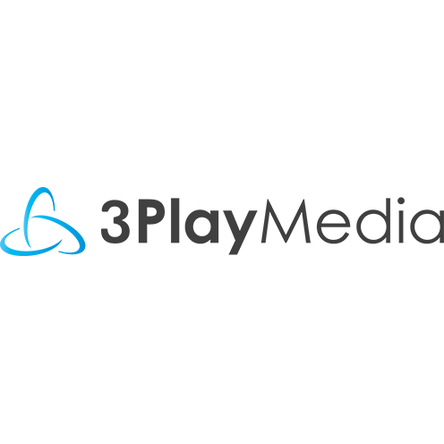
GLOBAL ACCESSIBILITY
PPT
Michele Landis
March 18, 2021

Slide 3
How Are We Doing
You
Me
Minneapolis
Humans

Slide 4
Stats
Current worldwide estimated population of 7.8 billion, approximately 4.93 billion people have access to and use the internet frequently
63.2% of the world population uses the internet
From 2000 to 2020, the usage of the internet increased by 1,266%

Slide 5
Stats
90.3% of North America & 87.2% of Europe have access to and use the internet every day
Middle East has seen a 5,227% growth in internet usage since 2000
34.5% of all websites use Word Press as their content management system
2020 showed 50.3% of internet traffic was from a mobile devise ( down 3% )
only .07% was mobile in 2009
63.38% use Google Chrome as their primary browser
19.25% do it on Safari and
3.77% leverage Firefox

Slide 6
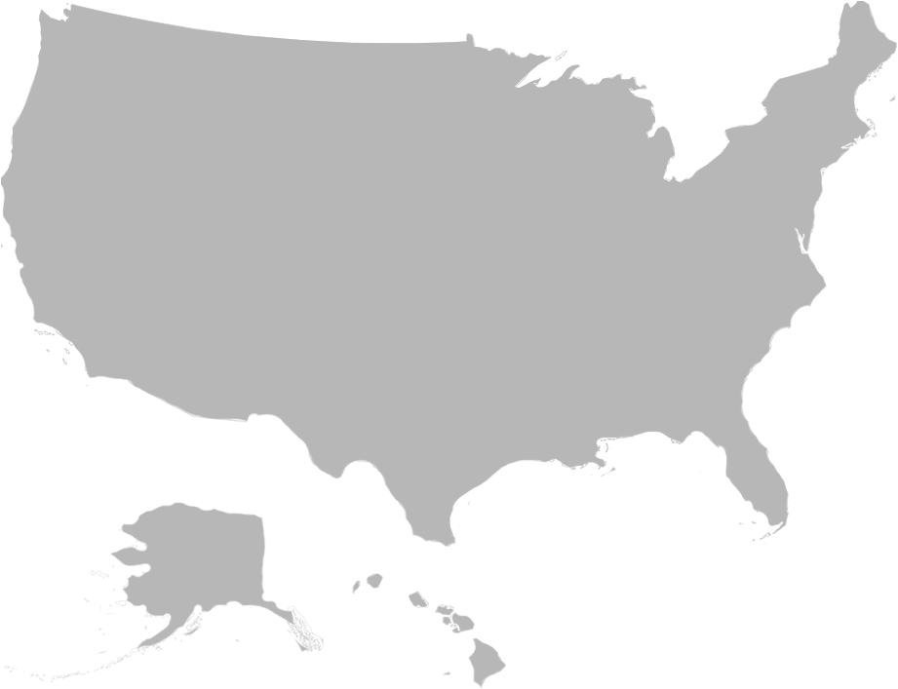
People With Disabilities
61 m
1 B
US Population with Disability
Disability affects more than one billion people worldwide
1 in 10
men are
color blind
1/3
US families have
at least one member
with a disability
$544 billion
Spending power
* CDC https://www.cdc.gov/
* The Global Economics of Disability - Fifth Quadrant Analytics
Notes:
Inaccessible Human Resources portals exclude millions of people
Disability affects approximate 61 million, or nearly 1 in 4 (26%) people in the United States. - Disability affects more than one billion people worldwide.^{1,2} According to the United Nations Convention on the Rights of Persons with Disabilities, people “. . . with disabilities include those who have long-term physical, mental, intellectual or sensory [such as hearing or vision] impairments which in interaction with various barriers may hinder their full and effective participation in society on an equal basis with others.” ³

Slide 7
Predictions
By 2024 the World health Organization will identify online shopping as an addictive disorder
by 2023, the number of people with disabilities employed will triple due to AI and emerging technologies reducing barriers to access
Cultural Changes are needed
Legacy Enterprise Systems need upgrading or replacing
Organizations that actively employ people with disabilities experience 89% higher retention rates, a 72% increase in employee productivity and a 29% increase in profitability. Plus, added diversity means added perspectives. Employees with disabilities bring a new lens to product development, increasing the potential for a product that appeals to a new client base.
Gartner
Notes:
Retailers may need to warn customers like how casinos here in the US have to promote responsible gambling
Using AI to increase accessibility at work was one of the Gartner Top 10 strategic predictions for 2020 and beyond. The predictions examine how technology is changing the definition of what it means to be human, and IT leaders must be prepared to adapt in a changing environment.
only 30% of qualified people with disabilities are employed
This represents a huge untapped talent pool during a time when hiring managers are warning about the availability of talent and its effect on the future of organizations

Slide 8
WCAG 2.2
The Accessibility Guidelines Working Group (AG WG)
Working Draft of the Web Content Accessibility Guidelines (WCAG) 2.2.

Slide 9
WCAG 2.2
Still not published
Augments, does not replace, 2.0 and 2.1
Backwards compatible (conforming to 2.2 means conformance to 2.1 & 2.0)
9 new and 1 updated success criteria
4 level A
4 level AA
1 level AAA
1 promoted from AA to A

Slide 10
WCAG 2.2
Why the New Version?
Continues the work started in WCAG 2.1
Improving accessibility guidance for
Users with cognitive or learning disabilities
Users with low vision
All disabled Mobile device users

Slide 11
Contact A360 for specific success criteria updates and changes within 2.2
michele@accessible360.com

Slide 12
WCAG 2.2
2.4.7 Focus Visible
Level A (used to be AA)
Any keyboard operable user interface has a mode of operation where the keyboard focus indicator is visible.

Slide 13
WCAG 2.2
2.4.11 Focus Appearance (Minimum)
Level AA
When user interface components receive keyboard focus, all of the following are true:
Minimum area: The focus indicator area is either:
at least as large as the area of a 1 CSS pixel thick perimeter of the unfocused component;
at least as large as a 4 CSS pixels border along the shortest side of the unfocused component, and no thinner than 2 CSS pixels.

Slide 14
WCAG 2.2
2.4.11 Focus Appearance (Minimum) Cont.
Change of contrast: The pixels making up the minimum focus indicator area achieve at least a 3:1 contrast ratio between their colors in the focused and unfocused states.
Adjacent contrast: The pixels in the minimum focus indicator area achieve at least a 3:1 against adjacent colors in the focused component or the minimum focus indicator area has a thickness of at least 2 CSS pixels.
Not fully obscured: The item with focus is not entirely hidden by author-created content.

Slide 15
WCAG 2.2
2.4.11 Focus Appearance (Minimum) Cont.
NOTE
A keyboard focus indicator which has a pattern or gradient may have parts that do not meet the 3:1 contrast ratio for the change of contrast, as long as an area equal to the minimum does meet the contrast ratio.
NOTE
If the component has a visible boundary smaller than the hit area, the size measure is taken from the visible boundary.
Focus indicator area
The pixels that are changed to visually indicate when a user interface component is in a focused state.

Slide 16
WCAG 2.2
2.4.13 Fixed Reference Points
Level A
For web content with page break locators, a mechanism is available to navigate to each locator.

Slide 17
WCAG 2.2
2.5.7 Dragging Movements
Level AA
All functionality that uses a dragging movement for operation can be operated by a single pointer without dragging, unless dragging is essential.
NOTE
This requirement applies to web content that interprets pointer actions (i.e. this does not apply to actions that are required to operate the user agent or assistive technology).
Reasoning
Some people cannot perform dragging motions in a precise manner. Others use a specialized or adapted input device such as a head pointer, eye-gaze system, or speech-controlled mouse emulator, which makes dragging cumbersome, error-prone, or outright impossible.

Slide 18
WCAG 2.2
2.5.8 Pointer Target Spacing
Level AA
For each target, there is an area with a width and height of at least 44 CSS pixels that includes it, and no other targets, except when:
Enlarge: A mechanism is available to change the CSS pixel size of each target, or its spacing, so there is an area with a width and height of at least 44 CSS pixels that includes it, and no other targets;
Inline: The target is in a sentence or block of text;
User agent: The size of the target is controlled by the user agent and is not modified by the author;
Essential: A particular presentation of the target is essential to the information being conveyed.

Slide 19
WCAG 2.2
3.2.6 Findable Help
Level A
For single page Web applications or any set of Web pages, if one or more of the following ways of finding help is supported, then access to at least one way of finding help is included in the same relative order on each page:
Human contact details;
Human contact mechanism;
Self-help option;
A fully automated contact mechanism.
NOTE
Access to help mechanisms may be provided directly on the page, or may be provided via a direct link to a different page containing the information

Slide 20
WCAG 2.2
3.2.7 Visible Controls
Level AA
Where receiving pointer hover or keyboard focus triggers user interface components to be visible, information needed to identify that user interface components are available is visible, except when:
The information needed to identify the user interface components is available through an equivalent component that is visible on the same page or on a different step in a multi-step process without requiring pointer hover or keyboard focus;
The component is provided specifically to enhance the experience for keyboard navigation;
A mechanism is available to make the information persistently visible;
Hiding the information needed to identify the component is essential.

Slide 21
WCAG 2.2
3.2.7 Visible Controls Cont.
NOTE
User interface components can be available through other visible components such as sub-menus, edit buttons, tabs, or thumbnails of media.

Slide 22
WCAG 2.2
3.3.7 Accessible Authentication
Level A
For each step in an authentication process that relies on a cognitive function test, at least one other authentication method is available that does not rely on a cognitive function test, or a mechanism is available to assist the user in completing the cognitive function test.
NOTE
Examples of mechanisms include: 1) support for password entry by password managers to address the memorization cognitive function test, and 2) copy and paste to help address transcription cognitive function test.

Slide 23
WCAG 2.2
3.3.7 Accessible Authentication Cont.
Cognitive function test
A task that requires the user to remember, manipulate, or transcribe information. Examples include, but are not limited to:
memorization, such as remembering a username, password, set of characters, images, or patterns. The common identifiers name, e-mail, and phone number are not considered cognitive function tests as they are personal to the user and consistent across websites;
transcription, such as typing in characters;
use of correct spelling;
performance of calculations;
solving of puzzles.

Slide 24
WCAG 2.2
3.3.8 Redundant entry
Level A
Information previously entered by or provided to the user that is required to be entered again in the same process and in the same user-session is either:
auto-populated, or
available for the user to select.
Exception: When re-entering the information is essential, or when previously entered information is no longer valid.
NOTE
Security verification, such as repeating a password, is considered essential.

Slide 25
WCAG 3.0

Slide 26
WCAG 3.0
See Draft
Not just new success criteria
A new approach to web accessibility
Expressly includes guidelines for web, mobile, and desktop applications
Not necessarily compatible with 2.X
Specifies how to test against the standards and how to score those tests
Anticipates substantial conformance in addition to full conformance

Slide 27
WCAG 3.0
Problems With Previous Versions
True/false accessibility does not match the real world
Accessibility is a spectrum
WCAG is all but useless for people new to accessibility
A 10 year (or even 2 year) refresh cycle fails to keep up with tech

Slide 28
What Else

Slide 29
Employment for People With Disabilities
Just three years from now, three times as many people with disabilities will be employed, thanks to advancements in AI and other technologies, Gartner
That means organizations will have to make their own internal digital platforms accessible to meet the needs of a more diverse workforce.
Taking these steps will lead to:
Higher retention rates
Increased productivity
Diversity in practice

Slide 30
Accessible Design
Inclusive design is going mainstream
Inclusive design means paying attention to the needs of all digital users from the early stages of your design process on
Planning to create the best user experience for everyone
Although it may seem obvious, it was rarely done
Giants like Apple and Microsoft share and promote their own inclusive design processes
We see smaller outfits are now understanding it can provide a competitive edge for them
Here at A360, we’ve seen a 350% + increase in requests for New Design Build Support over Q1 2020

Slide 31
U.S.
We had an official agenda item with our Executive Branch of our Gov’t – ANPRM
Eight years it sat on the list
No Action was taken
Plaintiff Attorneys jumped in
U.S Supreme Court said no to hearing a case on it
Litigation continues to be the driving force
Awareness and Education continue
Glimmers of hope on horizon

Slide 32
Affect of COVID
News Articles and live updates
Graphs & charts on the spread of the Virus
Testing sites
Prescription labels
MyChart type Patient Portals
Billing Statements
Mental Health and other routine care appointments went virtual
Online learning
Grocery shopping – simply getting essentials to the home

Slide 33
A Digital Democracy
Candidate Websites
Voting Machines
- back in October 2002, President George W. Bush signed into law the Help America Vote Act (HAVA)
Clear Ballot is one newer version of an accessible voting machine, past options were:
iVotronic, AVC Edge, eSlate, Vote-Trakker
More companies are designing polling stations that offer greater equitable access to people with disabilities.
Transition Websites
ASL @ Press Conferences Accessibility Statements
Notes:
Perkins School for the Blind tested Clear Ballot and found:
usable for a broad spectrum of voters with diverse abilities
95.65% of voters in the test group were able to successfully mark and cast their ballots
The mean accuracy of all voters in completing the 20 voting tasks as directed was 91.32%
The average time on task for completing the ballot was 16.5 minutes, a significant decrease from the average time of 20.7 minutes in the 2016 Clear Ballot usability test

Slide 34
What’s Happening Out There

Slide 35
Canada
10 Provinces & 3 territories
37.7 M people in CA
22% of Canadians are disabled
59% of PWD are employed
Strong Traditions of Human Rights Legislation in CA
Employment Equity Act 1985
AODA
Penalties now applied
Reconciliation of Province laws in the works
Federal Accessibility Initiative - Accessible Canada Act
Federal Public Service sites by July 2019
50+ employee companies in Ontario by Dec 2020

Slide 36
CA
First based on obligations
Now focused on eliminating barriers to accessibility
Act broadened the definition of disabilities to include permanent temporary or episodic
Not focused on the condition of the person now - rather focused on removing barriers in areas of activities
Employment
Access to the built environment
Programs and services
Information and communications Technology
Communications - using alternative methods like ASL
Changing culture and changing the mindset
Notes:
The term built environment refers to the human-made surroundings that provide the setting for human activity, ranging in scale from buildings and parks or green space to neighborhoods and cities that can often include their supporting infrastructure, such as water supply or energy networks.

Slide 37
Accessible Canada Act
1st legislation of it’s kind in CA - first Federal one
Applies to all federally regulated entities
Government, parliament & sectors of the economy, Fintech, Telecommunications, Banking & Transportation
Accessibility Standards Canada
Accessibility plans must be developed with direct involvement of PWD
those who use AT
Plans will be monitored and they’re required to report on progress
Act was Introduced in July of 2019
Regulations will be further described and reporting requirements will be coming
Penalties for noncompliance
Adopted, but the specific regs are not yet released

Slide 38
CA Approach
Canada’s Official Accessibility Strategy - what is this
Public Commitment to be a Role Model - lead by example
Prime minister appointed the first deputy minister of Accessibility
- head of a Federal Department - most Senior position - reports directly to the Prime Minister
- To develop an Accessibility strategy for the Federal Government
To meet of exceed their obligations
MAY OF 2019
Co-developed with public servants 12, 000+ who participated in the meetings and email campaigns
All this feedback creates the strategy
One Important Action Area is to Employ more people with disabilities
5.2 % of Federal Employees have a disability - so a was to go
Should be at least 9% - working on it
PWD have been a part of this form the beginning of the process
Legal activity impacting digital accessibility

Slide 39
The United Kingdom
Not following the EU Directive, developed their own Accessibility Regulations
All public sector websites created after September 23, 2018, the day said regulations came into effect, must be fully accessible within two years
meet WCAG 2.1AA by September 23, 2020
They must also have an Accessibility Statement
All public sector mobile apps must be accessible by June 23, 2021, and websites published on or after this date must already be accessible upon launch
The goal of these regulations is to create a legal incentive for websites and mobile applications to become accessible for people with disabilities, such as those who use assistive technology like screen readers and keyboard-only navigation
Unclear what the consequences will be, but this is enforced by the Government Digital Service (GDS)
Notes:
A360 Blog:
https://accessible360.com/accessible360-blog/2020-10-29-compliance-now-required-for-many-uk-companies/
Similar article from 3Play Media: https://www.3playmedia.com/blog/uk-digital-accessibility-regulations-update/#:~:text=All%20public%20sector%20bodies%20in%20the%20UK%20must%20make%20all,regulations%20differ%20depending%20on%20circumstances%3A&text=By%20Jun%2022%2C%202021%3A%20All%20mobile%20applications.

Slide 40
Denmark
Details
Date enacted: 2007
Responsible Entity (Agency, Ministry, etc.):
Ministry of Finance - Digitalization Agency
Danish: Digitaliseringsstyrelsen (dansk)
Type: Mandatory policy
Scope: Public sector
Web only: yes
WCAG Version Used: WCAG 2.0
Relevant Standard:
WCAG 2.0 Level AA W3C Web Content Accessibility Guidelines 2.0 Level AA
Relevant Documents:
The seven sets of mandatory open standards
Danish: De syv sæt af obligatoriske åbne standarder (dansk)
These standards are used for purchasing, development and operation of the websites of public authorities.

Slide 41
EU
What is Directive 2102?
The complete title is Directive (EU) 2016/2102 of the European Parliament and of the Council of 26 October 2016 on the accessibility of the websites and mobile applications of public sector bodies
Just like GDPR was standardization of privacy laws across EU, Directive 2016/2102 is standardization of accessibility laws across the European Union
And like GDPR it came into effect in 2016; 26 October 2016 to be exact
However, unlike the GPDR, it is a directive, not a regulation.
Notes:
https://directive2102.eu/

Slide 42
The EU Directive
Basics:
The rules laid out reflect the Commission's ongoing work to build a social and inclusive European “Union of equality” where all Europeans can take a full and active part in the digital economy and society
The Directive requires websites and apps of public sector bodies, (a few exceptions including broadcasters & live streaming) to meet specific accessibility standards:
an accessibility statement for each website and mobile app
a feedback mechanism so users can flag accessibility problems or request information published in a non-accessible content
regular monitoring of public sector websites and apps by Member States, and reporting on the results

Slide 43
EU Update
A public consultation in mid-2021 will allow the public, especially people with disabilities, to express their views on the Directive, the state of web accessibility, and measures or actions for improvement
To complement the public consultation, there will be additional specific consultations of key stakeholders
The European Commission will review the application of the Web Accessibility Directive by June 2022, with the findings made public soon after
Timeline for Review

Slide 44
China
Official law/policy page
English: Law on the Protection of Persons with Disabilities 1990, as amended
Details
Date enacted: 2008
Responsible Entities (Agencies, Ministries, etc.):
State Council of the People's Republic of China
China Disabled Persons' Federation (CDPF)
Type: Accessibility law
Scope: Public sector, Private sector
Web only: no
WCAG Version Used: None
In August 2019, China issued a new national standard [GB/T 37668-2019 ] for Information Requirements and Testing Methods for Accessibility of Web Content.
A “Recommended” standard beginning March 2020
Notes:
LAW

Slide 45
China
Voluntary Web Accessibility Standard
Official law/policy page
English: Voluntary Web Accessibility Standard
Details
Date enacted: 2008
Responsible Entity (Agency, Ministry, etc.):
Ministry of Industry and Information Technology (MIIT)
Type: Recommendation
Scope: Government
Web only: yes
WCAG Version Used: WCAG 2.0 derivative
Relevant Standard:
Technical Requirements for Web Accessibility YD/T 1761-2012
Notes:
https://www.w3.org/WAI/policies/china/

Slide 46
JAPAN
Web Content Japanese Industrial Standards (JIS)
On June 21, 2004, the Japanese Industrial Standard for Web accessibility, commonly referred to as the Web Content JIS was released
Although the Web Content JIS is not legally binding like the provisions of the Rehabilitation Act in the United States, it attracted attention as Japan's first public web accessibility guidelines

Slide 47
Japan
Standardization of Accessibility in the Area of Information Communications—Towards Barrier-Free Equipment and Services of Information Communications By Hajime Yamada (GLOCOM)
overview of Japan's early activities with regards to developing standards and policy regulating information communications
Ministry of Public Management, Home Affairs, Posts and Telecommunications (MPHPT) and the Ministry of Economy, Trade and Industry (METI) formed a system together in cooperation with understanding of the importance of providing Japanese Industrial Standards (JIS) for the elderly and people with disabilities
Websites: the Ministry of Posts and Telecommunications and the Ministry of Health and Welfare announced a guideline for creation of Internet web contents accessible by people with disabilities back in 1999
Notes:
https://webaim.org/articles/laws/world/asia

Slide 48
Global A11y Approach on Your Screen
Research
Share
Use WCAG 2.1 AA as your foundation &
Top it off with other details
Commit to Learning
Include stake holders
Accept this
Embrace it
Ask for Help

Slide 49
Compliance is a boring word
I hope you’re compelled to do the right thing
Strive to be truly Inclusive
Thank you

