Slide 1
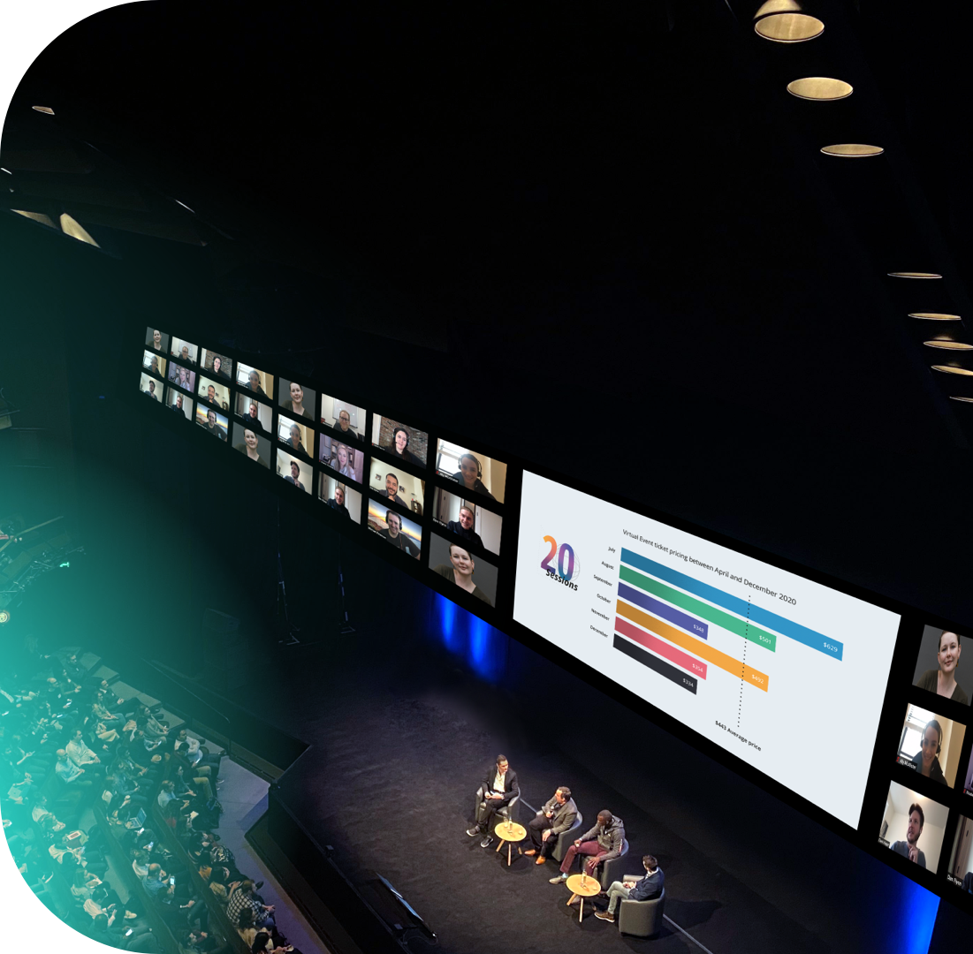
The Future of Business Events
5 Expert Predictions in 2021 & Beyond!
June 8, 2021
Notes:
Devin

Slide 2
Presenters
DevCleary Bizzabo
linkedin.com/in/devcleary
linkedin.com/in/raeruggieri/
Devin Cleary
VP of Global Events
Rachel Ruggieri
Director of Strategic Events
Notes:
Devin + Rachel Intro Individually

Slide 3
Unleash the Power of Professional Events to Create Impactful & Rewarding Experiences
Notes:
Rachel Confirm Today’s Purpose & Content Goal(s)

Slide 4
Experience
Economy
Notes:
Devin
Fundamental: Social status (Go to concerts to be part of the in crowd)
Social currency (physical in-person experiences I’ve had – who I am as a person)

Slide 5
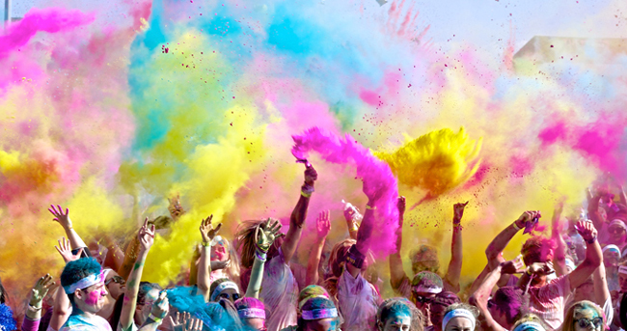
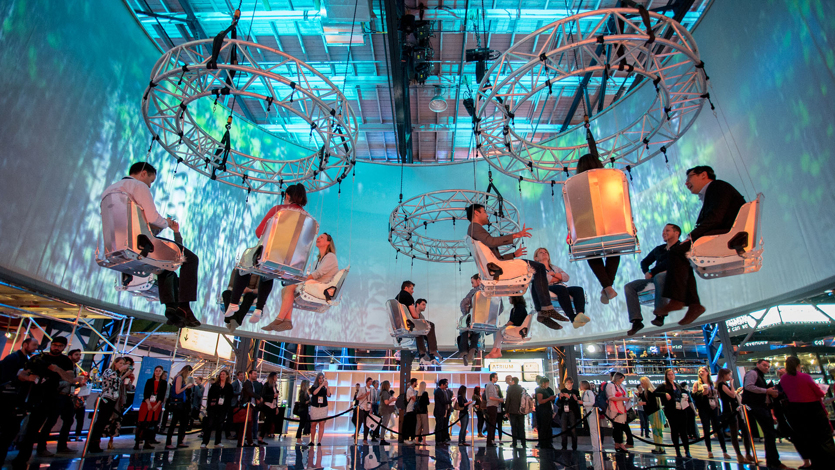
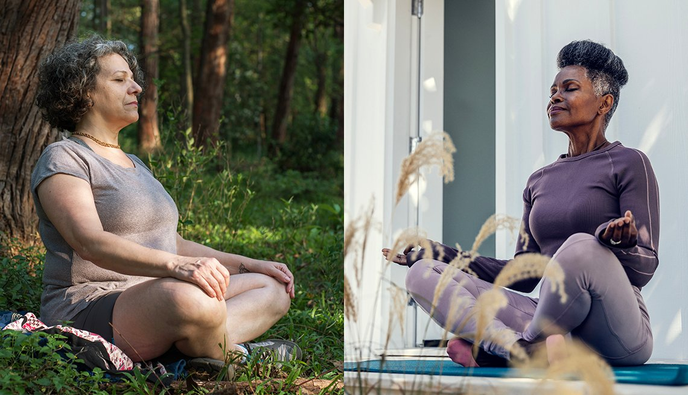
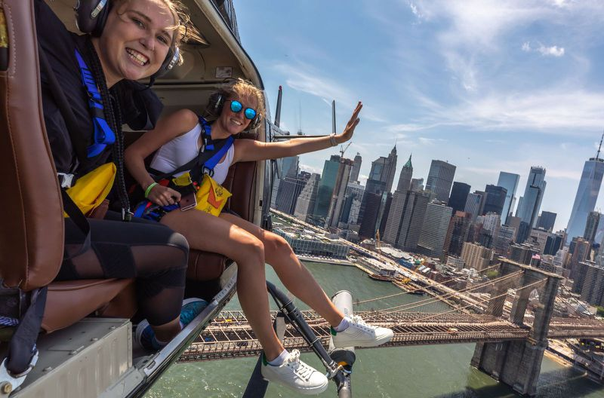
Status ∙ Well Being ∙ Usability ∙ Luxury ∙ Transformative ∙ Culture ∙ Peak Moments
Notes:
Devin
We are social creatures and virtual or hybrid events will never fully replace face-to-face meetings.

Slide 6
Virtual
Experience
Economy
Notes:
Devin

Slide 7
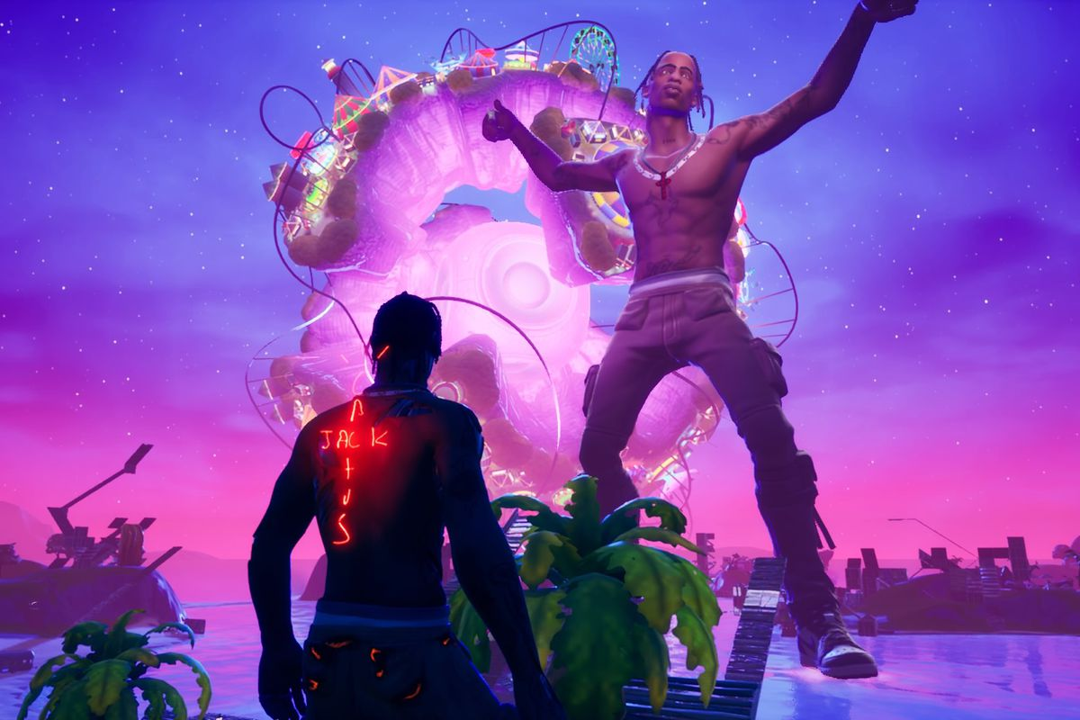
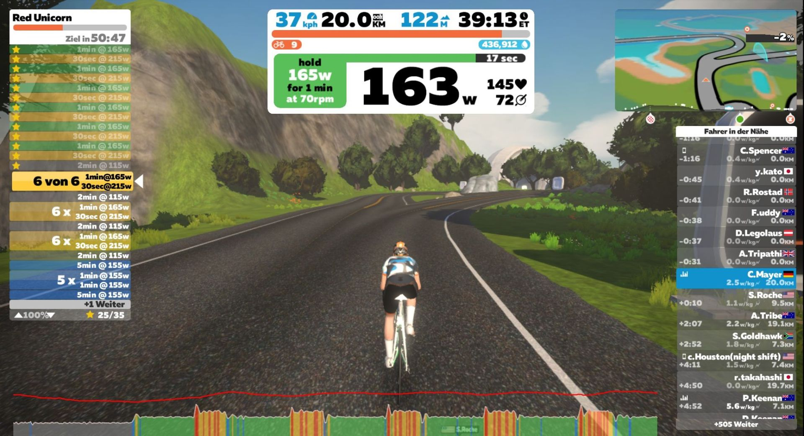
QUESTION
How will you create experiences that consumers value
as much as their real world experiences
Notes:
Devin + Rachel Asks Question
The whole point of events is to bring people together.
The rise of video game culture
Spending on virtual goods
Identity & belonging (displaying to your peers who you are as an individual and confirming what tribe you belong too)

Slide 8
Global Events
Industry
Notes:
Rachel

Slide 9
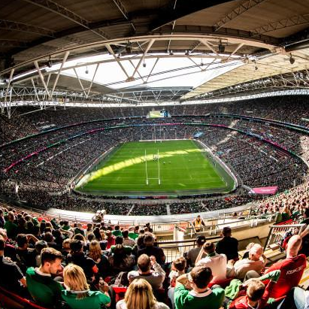
How It Started vs. How It’s Going
2020
2021
2022
Rise of Field & Guerilla Marketing + User Groups (Street or Museum Takeovers)
Regional Hospitality Plays (Coffee Shops, Entertainment, etc.)
Large Scale Events & Tradeshows (World Cup, Coachella, Super Bowl)
Zoom Boom
Hybrid Experimentation
Virtual Events Dominate
The New Hybrid
Notes:
Rachel 2020 & 2021 + Devin 2022
[Virtual events] will move away from regional events and become more industry-specific.

Slide 10
The Future of Events is Hybrid
72%
of Fortune 5000 companies reported they will need a Hybrid event tech solution
(Event Outlook Survey, 2020)
Pre-March 2020
The In-Person Era
March 2020
Virtual Transition Period
2021 - 2022
The Hybrid Era
Vast Majority of events are In-Person (95%+)
A moment in time; Virtual is the only option
In-Person is back; and Hybrid is an absolute must in order to truly lead
Notes:
Devin

Slide 11
The Future of
Business Events
Notes:
Rachel

Slide 12
Event Learnings From 2020
Content
Speakers
Interactivity
Sponsors
Content
Presenters
Interactivity
Sponsors
Optimal event duration: Half day or spread over 2-3 days
Sessions < 45 minutes
Incorporate rounds of Q&A or ask the experts
Case studies, certification and/or expert tips & tricks perform best
Live sessions vs. replays
Virtual events have yet to reach the captivating cult of a popular TV series
Know your presenters well – vet and source sample clips
Articulate + engaging
Leverage a host
Diversity is a must!
Offer training or create an event brief to prepare presenters
Leverage 30 min. roundtables or dedicated hangouts
Fan of polls, quizzing w/ instant results, or social media contests
Swag bags (even virtual) or gift vouchers offered to attendees – shared moments for engagement
Build always on engaging communities!
Be cautious of virtual tradeshows
“So what” test
Notes:
Rachel
Elevate learning and development impact
Virtual events will focus more on live sessions and scale back or eliminate replays

Slide 13
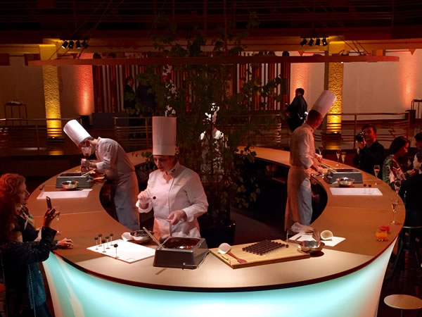
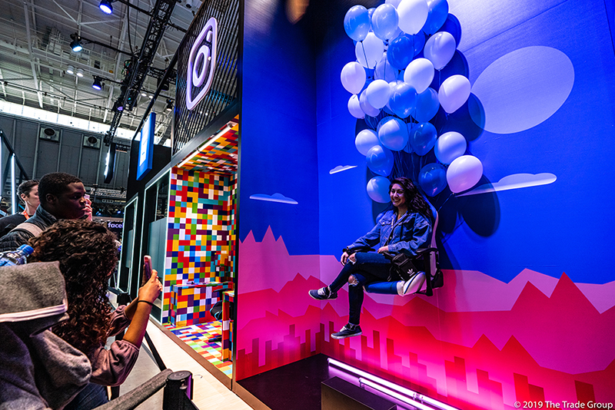
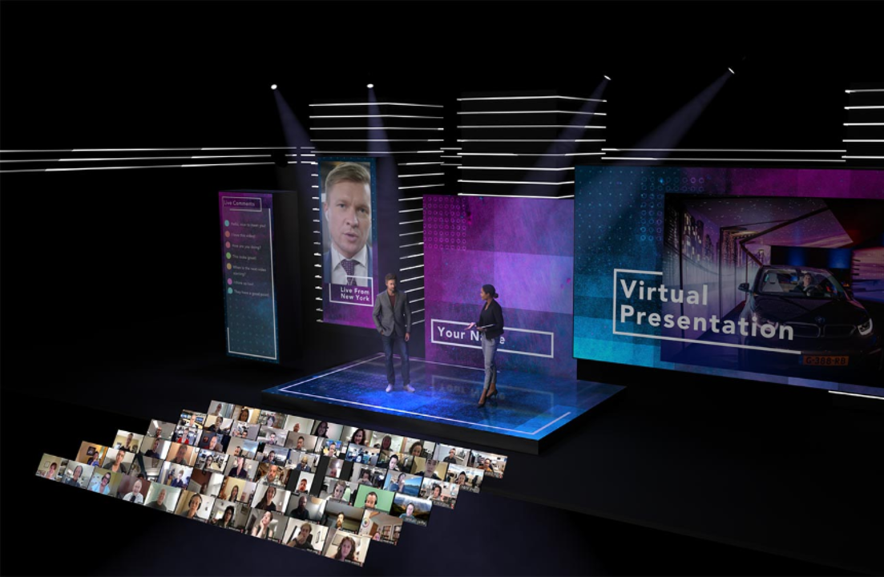
A Good vs. Outstanding Event
1. Multi-Sensory
2. Experiential
3. Authentic
Element of Fun ∙ Frustration Management ∙ Surprises ∙ Create Anticipation ∙ Spontaneity
Notes:
Devin
I believe feelings make events outstanding | create an emotional response

Slide 14
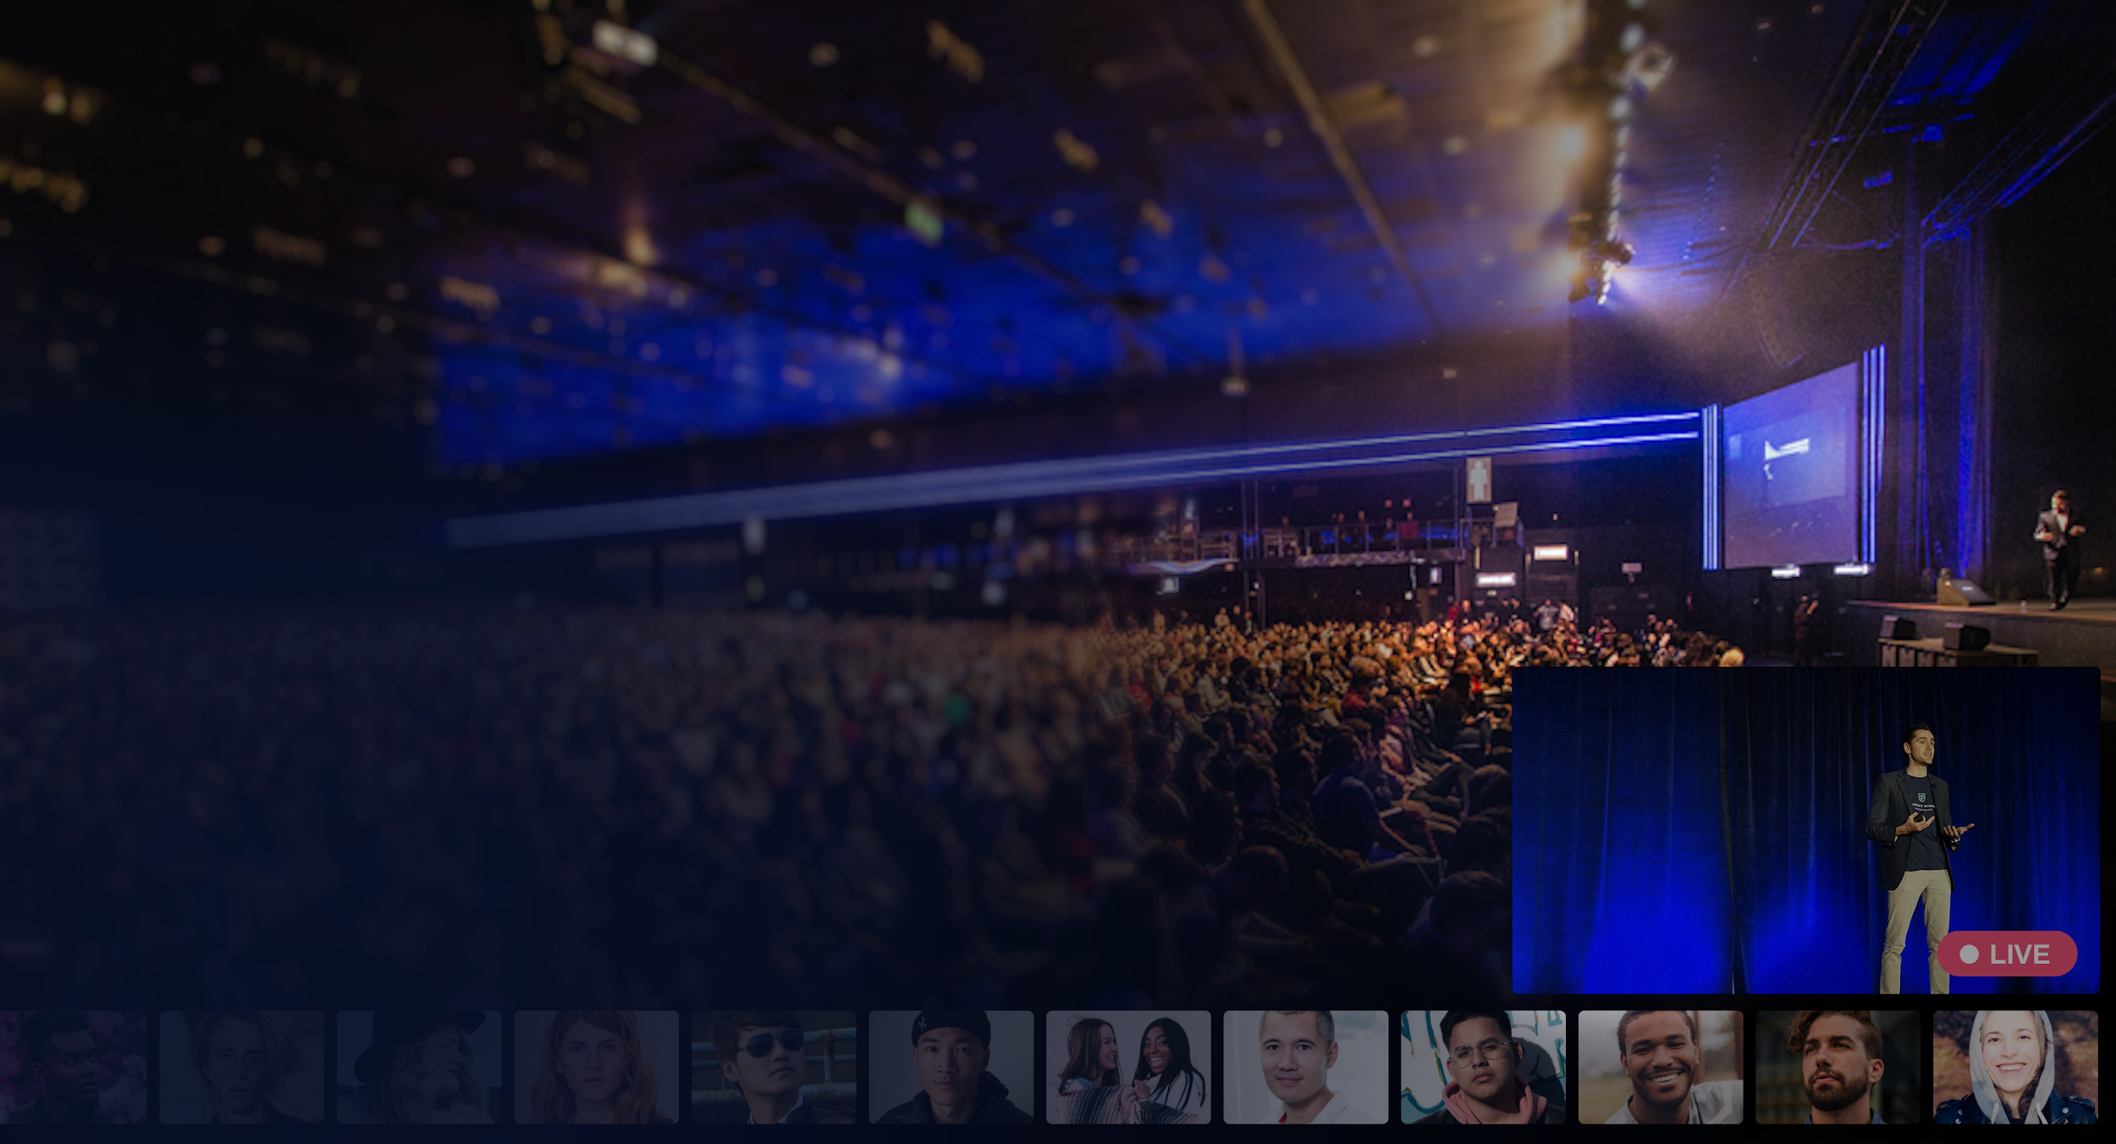
“Events will not be one-off occurrences, but rather become part of an organizations multi-sensory omnichannel marketing strategy.”
© 2021 Bizzabo Confidential
Notes:
Devin

Slide 15
5 Expert
Predictions
Notes:
Devin

Slide 16
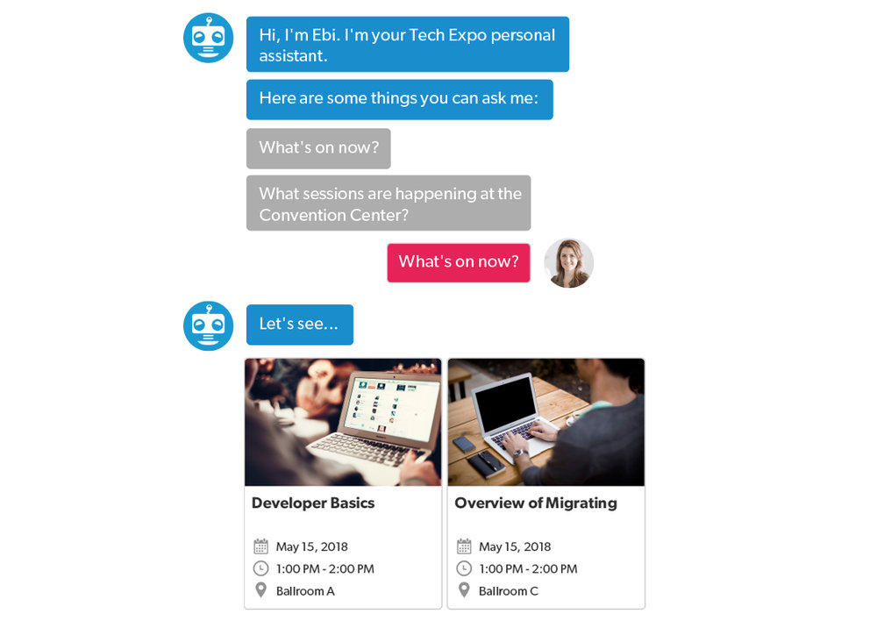
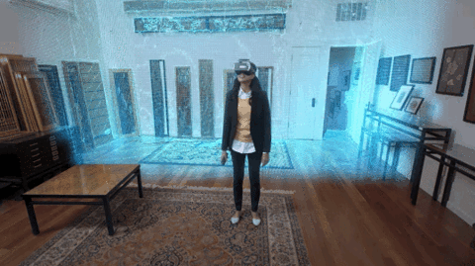
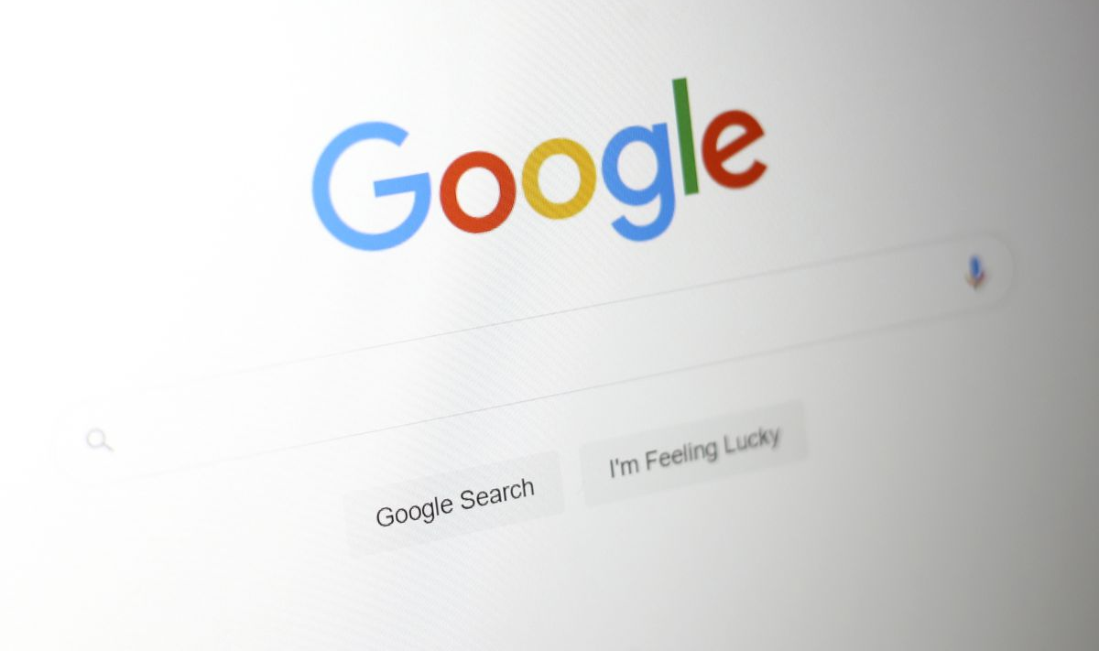
#1 Tech Trends
REMOTE WORK
INTERNET OF BEHAVIORS
DATA & PRIVACY
MIXED REALITY ADOPTION
ROBUST AI
Notes:
Devin

Slide 17
#2 Business Travel
Business + international travel still in a slump for the remainder of 2021
(EOY = ↑ 65% of pre-pandemic levels)
Business travel will benefit from leisure travel
Professionals will flock to in-person association events in 2022
Professionals will prioritize larger meetings as they travel to fewer individual appointments
Source: Bloomberg
Notes:
Rachel
CFO cutting operating costs wherever we could – a.k.a. business travel
Benefits of face-to-face will remain!
Helping bridge the distance between countries and continents
In-person events will return slowly after Sept. 2021. Folks will start with in-country events first and as numbers start decreasing, folks will start traveling international for business

Slide 18
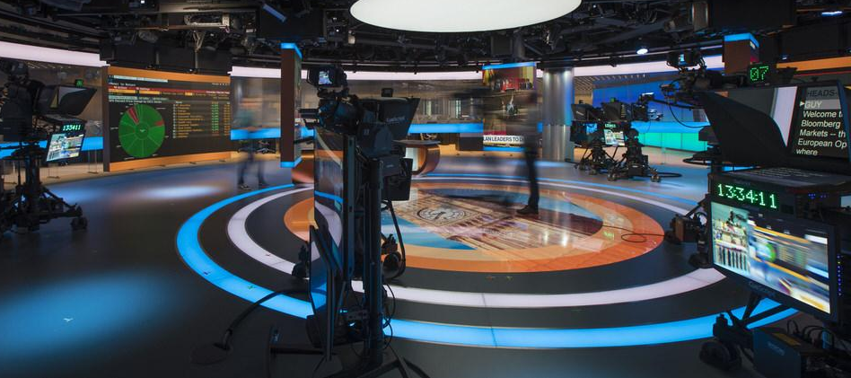
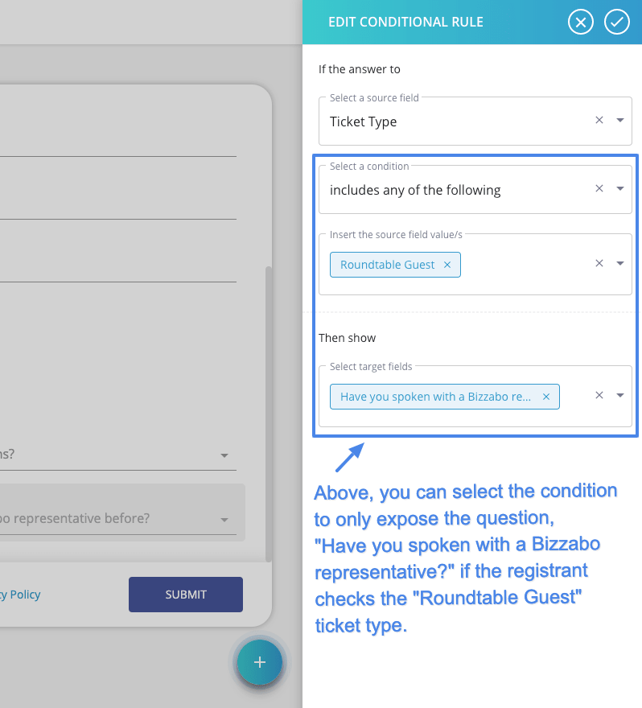
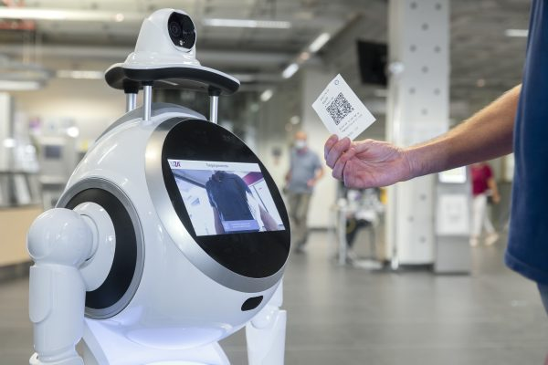
#3 Event Best Practices
INCLUSION 2.0
EVENT CONTENT RESET
NON-CONVENTIONAL SPACES
THOUGHTFUL SUSTAINABILITY
PERSONALIZATION
HYPER AUTOMATION
Notes:
Devin
Safety is the new luxury! After a year of being repeatedly told we are not safe to leave the house, making people feel safe and welcome must be key to any event. Establishing trust will be a critical component to the marketing strategy, and clear communication about safety protocols must be emphasized. Every component of events will be supported by digital, touchless communication. Designing for safety will be an essential strategy. The north star of any gathering will be creating an experience where trust is the baseline, wellbeing is prioritized, and individuals feel comfortable to interact.
We’re probably going to see more ‘enter at your own risk’ language in tandem with a photo release form and liability clauses included at events
Infuse near-future events and activations with company values and opportunities for social impact
Optimize the on-demand experience is going to be key as more and more people expect flexibility in “online hours.”
Embrace bite-sized ‘snackable’ content

Slide 19
#4 Budget
Expected event spend for 2021 in North America is down 6% compared to 2020
Return of revenue! 2H 2021 = Making money with virtual
Anticipate 30 – 40% increase in spend for hybrid events
Notes:
Rachel

Slide 20
#5 Accessibility
Websites accessible to all!
Real-time captioning a must
Audio to combat fatigue
More robust pre-event communications (e.g., checklist in your registration or confirmation email)
Preferred pronouns displayed on badges
Notes:
Rachel + Devin (Each Share Preferred Learning Style)
The words you choose matter (Person first)
Put accessibility information in your event page footer.

Slide 21
Measuring Success
Event Targets
Business Impact
Employee Satisfaction
NPS, Registration #, Attendance, Customer Engagement
MQL’s, Meetings, Pipeline
Mood Tracker, Turnover, etc.
Level of Learning & Knowledge
How We Spend Our Time
Rate of Team Development & Progress
Operating Efficiently? Focused on Main Priorities?
Notes:
Devin

Slide 22
The NEW
Hybrid Model
Notes:
Rachel
A hybrid event format brings together the charm of physical presence as well as the convenience of remote participation.

Slide 23
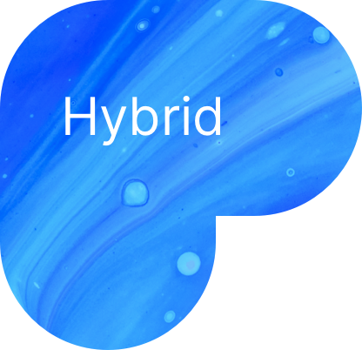
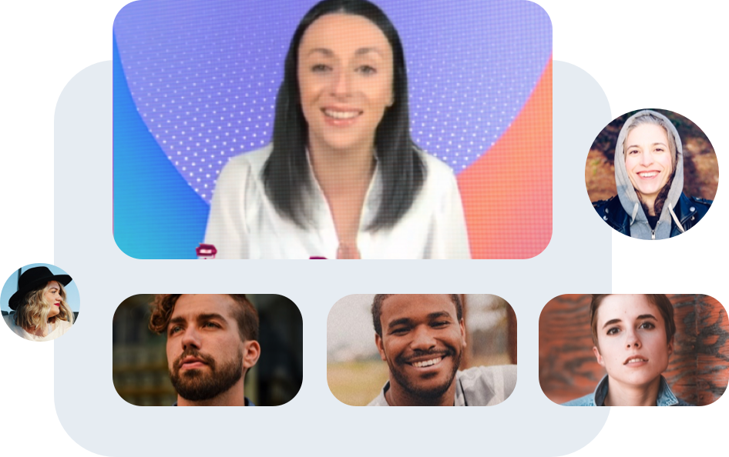
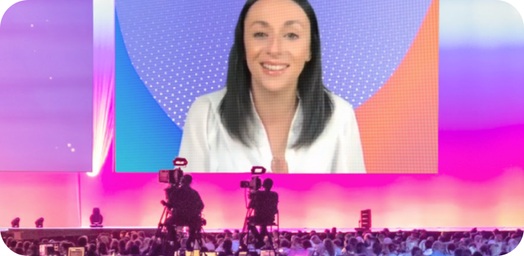
The Attendee and Organizer Experience in the New Era
We must re-imagine the experience with a holistic mindset for In-Person, Virtual, and Hybrid events
Hybrid
1) A seamless integration of technology to facilitate participation between a live and virtual audience
2) An experience that caters to all audiences in a viewer-friendly way
3) Putting your live + online audience on the same level
Virtual
In-Person
Notes:
When looking at the planning something has to come first
Tech enabler brings all together | Innovative NEW ways to engage people who are broadly distributed
Connect people across geographies with exciting shared experiences
The in-person event will need to emphasize networking and relationship building while the digital experience will need to have a separate user journey customized to keep the attendee engaged. An added benefit of the hybrid event that makes it compelling to businesses is an entirely new set of metrics, such as the ROA (Return on Attention), which is one of the reasons these hybrid events will stick.
“Do we want to be the first brand in your market to return to live events, or the last?” = FOMO

Slide 24
Q&A
Notes:
Devin

Slide 25
Confidential © Bizzabo 2021
Notes:
-

