Slide 1
Training on Accessibility
Emily Ogle

Slide 2
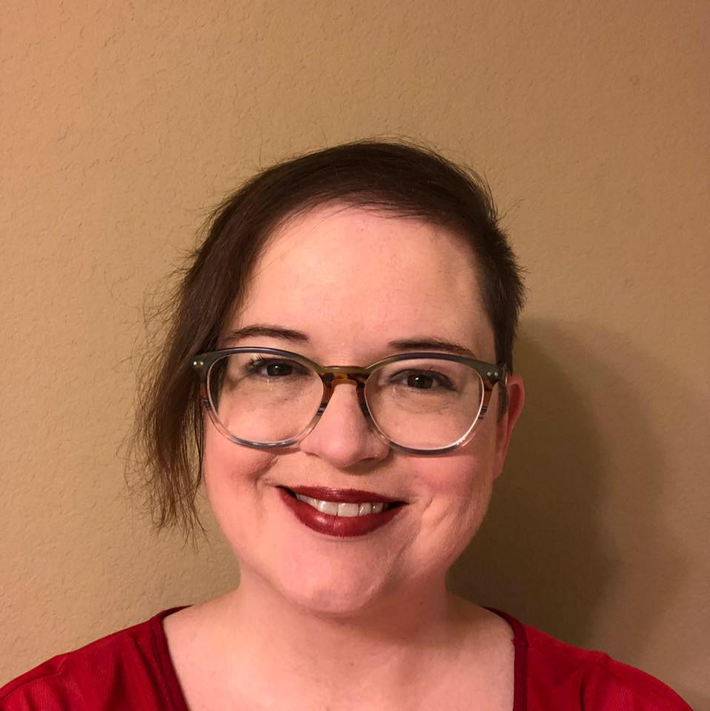
Introduction
A little bit about me:
Hard-of-hearing hearing aid user
Lifelong closed caption user
Neverending advocate for those with disabilities

Slide 3
Objectives
Introductory: what all training should include for accessibility
Mid-level: what training for those who want to know more should include
Detailed: the variety of ways to provide training for those learning at a granular level

Slide 4
Tiers of training
1
Introductory
2
Mid-Level
3
Detailed

Slide 5
Introductory: starting out with the basics
1
Introductory
1 hour

Slide 6
Goals for introductory training
Provide a high-level perspective of accessibility
Indicate who the primary users are
Build empathy
Have users walk away thinking about accessibility

Slide 7
High-level perspective of accessibility
Discuss keyboard, assistive technology, color, responsive design
Provide demonstrations of good and poor accessibility
Talk through the steps you’re taking as you demonstrate
“I press the tab key,” “I’m using the arrow keys,” “I’m using CTRL + to zoom in”
When demonstrating a screen reader, provide expectations
“I’m going to tab to this Save button, so I expect to hear ‘Save, button’”
Discuss benefits of accessibility, such as employment, retail, education, etc

Slide 8
Who are the primary users?
Summarize the groups who benefit from digital accessibility
People who are blind
Can’t see so they need textual or audio output
Those with low vision
Can see some but may rely on magnification software
Those who can’t perceive all colors
Need supplemental cues in addition to color
Deaf/hard-of-hearing
Need visual or textual equivalents
Limited mobility or strength
Might not use a mouse
Neurodiverse
May depend on a lot of the same principles as other user groups

Slide 9
Activities
Try to keep training interactive
Leverage everyday situations and apply an accessibility lens
Banking – before accessibility, some people had to depend on others to tell them how much money they had in their account
Wheelchair ramps – how many people use these ramps for strollers or grocery carts?
Point out some things that started out as inventions for people with disabilities
Texting, step stools, closed captioning, Siri/PAs
When building empathy, avoid empathy exercises that are reductive, such as having participants all use wheelchairs

Slide 10
Mid-level: building a foundation of knowledge
Introductory
1 hour
1
Mid-Level
1-2 hours
2

Slide 11
Goals for mid-level training
Training is focused on key areas of accessibility
The user experience receives more focus

Slide 12
Key areas of accessibility
More detail on accessibility themes
Keyboard, assistive technology, color, responsive design, forms
Design, development, and testing
Key roles in accessibility integration
Designer
User experience (UX)
Developer
Tester
End user*

Slide 13
Providing further details on key areas
Talk about why it’s important to test keyboard independently from keyboard + assistive technology
Discuss the relationship between keyboard accessibility and assistive technology
“Developers can ensure programmatic capability for all elements but if users can’t get to it, then they might not know it’s even there”
Talk about the hierarchy of prioritization when it comes to keyboard and assistive technology
Show simulations of low contrast content with blurred setting using browser extensions
https://www.washington.edu/accesscomputing/AU/before.html

Slide 14
Providing further details on key areas pt 2
End user*
Designer
Developer
Tester
User experience
Provide charts or flow diagrams to show where accessibility fits in with design, development, testing
Talk about the key roles for accessibility and speak to the importance of every role from planning to validation
All roles need to be involved in integrating accessibility

Slide 15
Humanize accessibility
Devote time for several user groups who benefit in particular from accessibility best practices
Blind, low vision, color blind, deaf/HOH, keyboard users, neurodiverse
For some groups, more time is necessary because making software accessible is more complex
Blind, neurodiverse
For some groups, accessibility is fairly straightforward
Deaf/HOH, keyboard users, color blind
Some user groups don’t have enough official accessibility considerations
Low vision, neurodiverse
http://blogs.quovantis.com/wp-content/uploads/2016/06/accessibility-banner.png

Slide 16
Vision: examples

Slide 17
Blind users
Keyboard accessibility has a direct relationship with assistive technology
Blind users may need to use a screen reader to operate a webpage
All elements on the web page need programmatic equivalents
Blind users also may browse in a non-linear way, so context is key
Headings, images, links

Slide 18
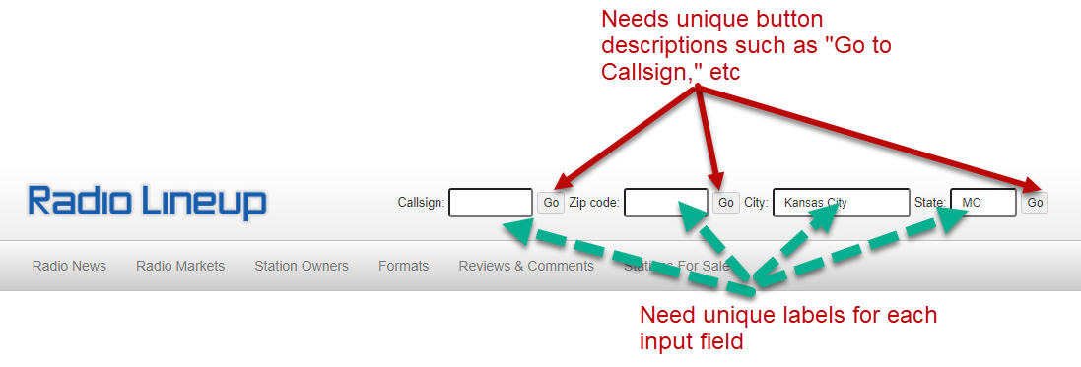
Assistive technology: example
https://www.radiolineup.com/locate/Kansas-City-MO

Slide 19
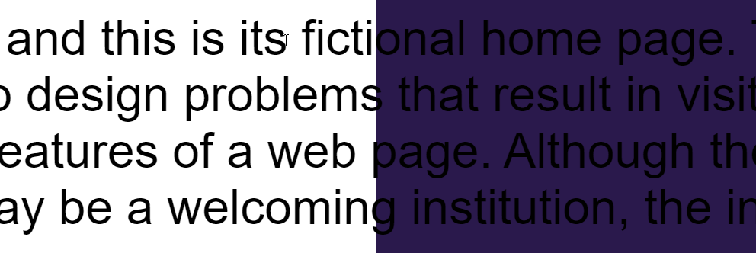
Low vision users
Key accessibility themes for users with low vision are color contrast, reflow, resizing, responsiveness
Even though people with low vision comprise the majority of vision disabilities, accessibility considerations are still behind
When considering low vision, don’t assume your user uses a screen reader
They could be using magnification software such as Zoomtext or simply relying on large font size settings

Slide 20
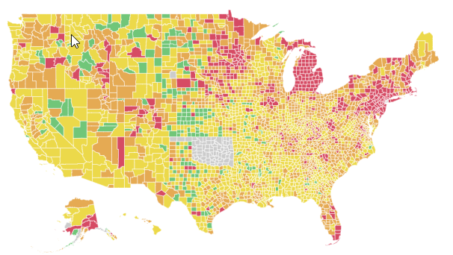
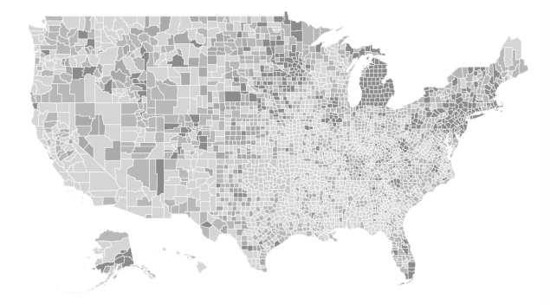
Color blind users
8% of the population has color blindness
Red-green deficiency is the most common
Data can be lost if color alone is used to convey information
Color can still be used—just not as the only thing
https://globalepidemics.org/key-metrics-for-covid-suppression/

Slide 21
Activities for mid-level training
Gut-check – have people open a tool they use often and look for barriers they hadn’t noticed prior to the training
Hands-on assessment – provide a website for everyone to reference and spend 20-30 minutes looking over the same content
Group activities – each group takes on a persona to assess a website from an end user’s perspective
Polls or knowledge checks
Comparison exercises – choose which item is instinctively better to you (more accessible versus less accessible)

Slide 22
Detailed: applying to your work
1
Introductory
1 hour
2
Mid-Level
1 – 2 hours
3
Detailed
2 hours – 2 days

Slide 23
Goals for detailed training
Participants walk away being able to apply topical themes in their work or life
Themes can be based around
Criteria
User groups/personas
Assistive technology
Regulations
Documents
All of the above

Slide 24
Detailed training: for deeper learning
Accessibility is complex and there are numerous ways to train
Emphasis during any training is that learning never ends
There’s always some new technology or innovation that brings about new accessibility considerations
Always incorporate the end user in any training

Slide 25
Criteria-based training
Participants are learning the specific criteria that need to be met
Web Content Accessibility Guidelines (WCAG) Levels A, AA is the foundation of accessibility criteria
User groups need to be integrated throughout for training to be effective
Participants may be learning to assess, design, or remediate against the criteria
Learning will take time, so 2 days of training would be best
WCAG’s POUR principles provide the structure for the training
Perceivable
Operable
Understandable
Robust

Slide 26
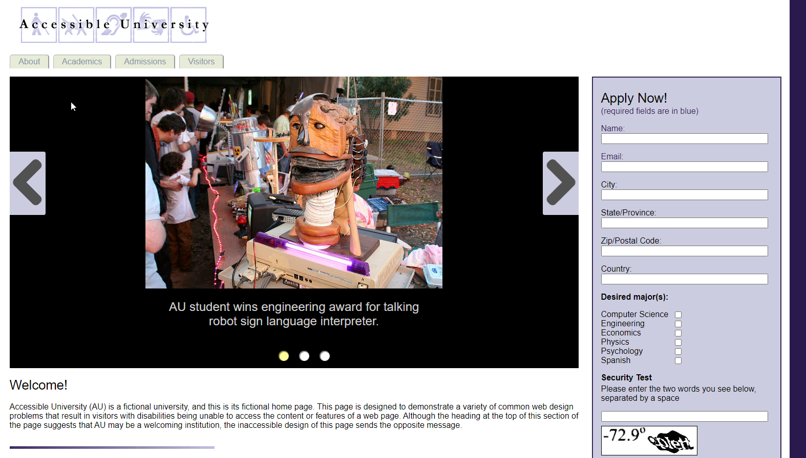
Activities for criteria-based training
Demonstrations per criterion or level
Group activities where groups concentrate on a POUR principle
Visit pre-designed inaccessible pages (W3C demonstrations, Washington University)
Name that User game
For each criterion, name the users who benefit

Slide 27
User groups/persona training
Building on mid-level training – 2 hours
Provide tips on conducting focus groups with disabled users
Allowing users to provide feedback in their preferred environment
Using inclusive language
Using the preferred communication method
Leveraging the assistive technologies users are already familiar with
Best practices for creating user acceptance criteria test scripts
Developing personas to create requirements
Leveraging user research to create user stories

Slide 28
Activities for user group/persona training
Who Am I? exercise
Create a story that describes the barriers the user experiences
“I get to a website but I don’t know what the name of it is”
Participants indicate the possible disabilities that may be associated with that barrier
People who rely on screen readers need to know the title of each web page; people with distraction disorders may need a page title to reorient themselves
Who’s left standing? Visual
Create a list of everyday scenarios that people are likely to experience
Have people stand at the beginning of the exercise (or equivalent)
When scenario is applicable, have them sit and remain seated
Go through all scenarios and see who is still standing

Slide 29
Assistive technology (AT) training
Participants may be learning about AT to understand how to develop for it or understand the user experience
6 – 8 hours
Define the different types of assistive technologies
Screen reader, speech input, puff detection, eye tracking
Discuss the role of user agents
User Agent Accessibility Guidelines
Emphasize the importance of following development best practices

Slide 30
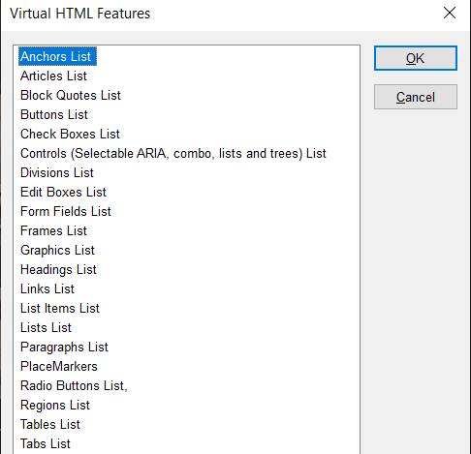
Activities for assistive technology training
Download free screen reader such as NVDA (non-visual desktop access)
Voiceover is standard on all Mac devices
Use built-in screen reader or voice command on mobile devices
Test webpages using browser extensions
View HTML viewers in screen readers

Slide 31
Regulation training
Training about accessibility training may be in conjunction with other types of detailed training, such as criteria-based training
1 - 2 hours
Include information on the Americans with Disabilities Act or other equivalents
Discuss WCAG and its various iterations
WCAG 2.0, 2.1, 2.2; WCAG 3.0 silver
Government regulations
Section 508 (U.S.)
EN 301 549 (E.U.)
https://www.gpsmycity.com/img/gd/2953.jpg

Slide 32
Activities for regulation training
Create a tree chart demonstrating the hierarchy of accessibility regulations
Rehabilitation Act
Section 508
WCAG 2.0
Chapter 5

Slide 33
Document training
Document accessibility is a niche area of accessibility
PDF accessibility experts in particular are highly sought after
2-3 hours for most documents; 1 day for PDFs
PDFs, Word, PowerPoint, Excel, Adobe InDesign all need accessibility
PDFs require documents to be tagged to be accessible
Microsoft products come with accessibility checkers
Discuss conversion process and post-conversion work

Slide 34
Activities for document training
Run accessibility checker
Make note of what checker does not catch
Make note of false positives
Create document that passes the checker but is unusable
Color contrast of clashing colors
Using color alone to convey information
Demonstrates importance of user experience inclusion
Demonstrates that checkers do not catch everything

Slide 35
Making training accessible
Practice what you preach!
Use videos that have closed captioning
Describe images or visuals
Don’t use references to location, shape, direction, etc
“Click over here to select the button” → “Select the ‘Save’ button”
Place links behind text
When using charts and graphs, provide table equivalents or shapes in addition to color
Determine accommodation needs prior to training
Use inclusive language

